Slide 1

Chapter 2
Sources of Innovation
Strategic Management of Technological Innovation, 7th Edition
Melissa A. Schilling
© McGraw Hill LLC. All rights reserved. No reproduction or distribution without the prior written consent of McGraw Hill LLC.

Slide 2
The Rise of Cultured Meat
In late 2017, Bill Gates, Jeff Bezos, Jack Ma and others began funding efforts to grow “clean meat”.
Growth in demand for meat expected to outpace supply.
Animal production has large negative impacts environment: greenhouse gasses, heavy water and energy use.
Animal production is inefficient: 1 calorie of beef requires 23 calories of inputs versus 3 required for one calorie of “clean meat”.
Developing clean meat.
Jason Matheny founded New Harvest to promote research; collaborated with Dutch scientist and government.
Early efforts were very expensive ($1200 for first meatball).
By 2021 there were dozens of startups, and Eat Just had already launched cultured chicken.

Slide 3
The Rise of “Clean Meat”
Discussion Questions:
What were the potential advantages of developing cultured meat? What were the challenges of developing it and bringing it to market?
What kinds of organizations were involved in developing clean meat? What were the different resources that each kind of organization brought to the innovation and what were their motives?
What are the challenges to gaining wide market acceptance of cultured meat, and how could these organizations facilitate that? Can you think of other products or services that faced similar challenges?

Slide 4
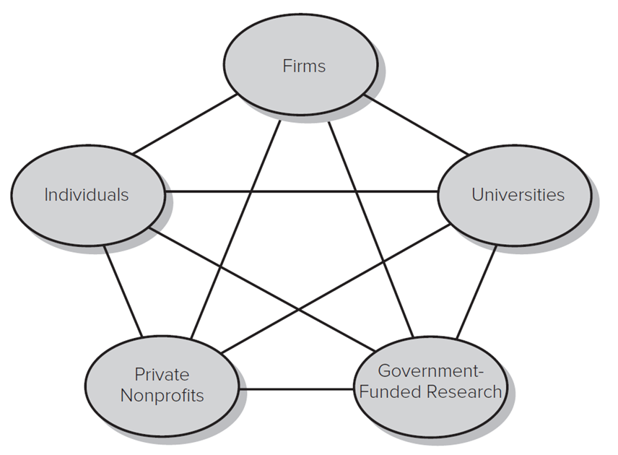
Overview
Innovation can arise from many different sources and the linkages between them.
Access the text alternative for these images.

Slide 5
Creativity 1
Creativity: The ability to produce work that is useful and novel.
Individual creativity is a function of:
Intellectual abilities (for example, ability to articulate ideas).
Knowledge (for example, understand field, but not wed to paradigms).
Personality (for example, confidence in own capabilities).
Motivation (for example, rely on intrinsic motivation).
Environment (for example, support and rewards for creative ideas).

Slide 6
Creativity 2
Organizational Creativity is a function of:
Creativity of individuals within the organization.
Social processes and contextual factors that shape how those individuals interact and behave.
Methods of encouraging/tapping organizational creativity:
Idea collection systems (for example, suggestion box; Google’s idea management system).
Creativity training programs.
Culture that encourages (but doesn’t directly pay for) creativity.

Slide 7
Theory in Action 1
Inspiring Innovation at Google.
Google uses a range of formal and informal mechanisms to encourage its employees to innovate, including:
20% Time (all engineers are encouraged to spend 20% of their time working on their own projects).
Recognition awards.
Google Founders’ Awards.
Ad sense Ideas Contest.
Innovation reviews.

Slide 8
Translating Creativity into Innovation
Innovation is the implementation of creative ideas into some new device or process.
Requires combining creativity with resources and expertise.
Inventors.
One ten-year study found that inventors typically:
Have mastered the basic tools and operations of the field in which they invent, but they will have not specialized solely on that field.
Are curious, and more interested in problems than solutions.
Question the assumptions made in previous work in the field.
Often have the sense that all knowledge is unified. They will seek global solutions rather than local solutions and will be generalists by nature.
Such individuals may develop many new devices or processes but commercialize few.

Slide 9
Theory in Action 2
What Breakthrough Innovators Have in Common.
A study of individuals (published in “Quirky: The remarkable story of the traits, foibles, and genius of breakthrough innovators who changed the world” identified as serial breakthrough innovators identified some key commonalities:
They felt a sense of “separateness and tended to challenge rules.
They had intense faith in their ability to achieve their objectives.
They were keenly idealistic.
They began with modest means and worked very hard for their success.
They were often self taught.
Understanding how these factors helped them become breakthrough innovators reveals how anyone can nurture breakthrough innovation potential.

Slide 10
Transforming Creativity into Innovation 1
Innovation by Users.
Users have a deep understanding of their own needs, and motivation to fulfill them.
While manufacturers typically create innovations to profit from their sale, user innovators often initially create innovations purely for their own use.
For example, Laser sailboat developed by Olympic sailors; Indermil tissue adhesive based on Superglue; early snowboards.

Slide 11
Transforming Creativity into Innovation 2
Research and Development by Firms.
Research refers to both basic and applied research.
Basic research aims at increasing understanding of a topic or field without an immediate commercial application in mind.
Applied research aims at increasing understanding of a topic or field to meet a specific need.
Development refers to activities that apply knowledge to produce useful devices, materials, or processes.

Slide 12
Transforming Creativity into Innovation 3
Research and Development by Firms.
Science Push approaches suggest that innovation proceeds linearly:
Scientific discovery → invention → manufacturing → Marketing.
Demand Pull approaches argued that innovation originates with unmet customer need:
Customer suggestions → invention → Manufacturing.
Most current research argues that innovation is not so simple and may originate from a variety of sources and follow a variety of paths.

Slide 13
Transforming Creativity into Innovation 4
Firm Linkages with Customers, Suppliers, Competitors, and Complementors.
Most frequent collaborations are between firm and their customers, suppliers, and local universities.
Collaborates with: | North America (%) | Europe (%) | Japan (%)
Customers | 44 | 38 | 52
Suppliers | 45 | 45 | 41
Universities | 34 | 32 | 34

Slide 14
Transforming Creativity into Innovation 5
Firm Linkages with Customers, Suppliers, Competitors, and Complementors.
External versus Internal Sourcing of Innovation.
External and internal sources are complements.
Firms with in-house R&D also heaviest users of external collaboration networks.
In-house R&D may help firm build absorptive capacity that enables it to better use information obtained externally.

Slide 15
Transforming Creativity into Innovation 6
Universities and Government-Funded Research.
Universities.
Many universities encourage research that leads to useful innovations.
Bayh-Dole Act of 19 80 allows universities to collect royalties on inventions funded with taxpayer dollars.
Led to rapid increase in establishment of technology-transfer offices.
Revenues from university inventions are still very small, but universities also contribute to innovation through publication of research results.

Slide 16
Transforming Creativity into Innovation 7
Universities and Government-Funded Research.
Governments invest in research through:
Their own laboratories.
Science parks and incubators.
Grants for other public or private research organizations.

Slide 17
Transforming Creativity into Innovation 8
Private Nonprofit Organizations.
Many nonprofit organizations do in-house R&D, fund R&D by others, or both.
The top nonprofit organizations that conduct a significant amount of R&D include organizations such as the Howard Hughes Medical Institute, the Mayo Foundation, the Memorial Sloan Kettering Cancer Center, and SEMATECH.

Slide 18
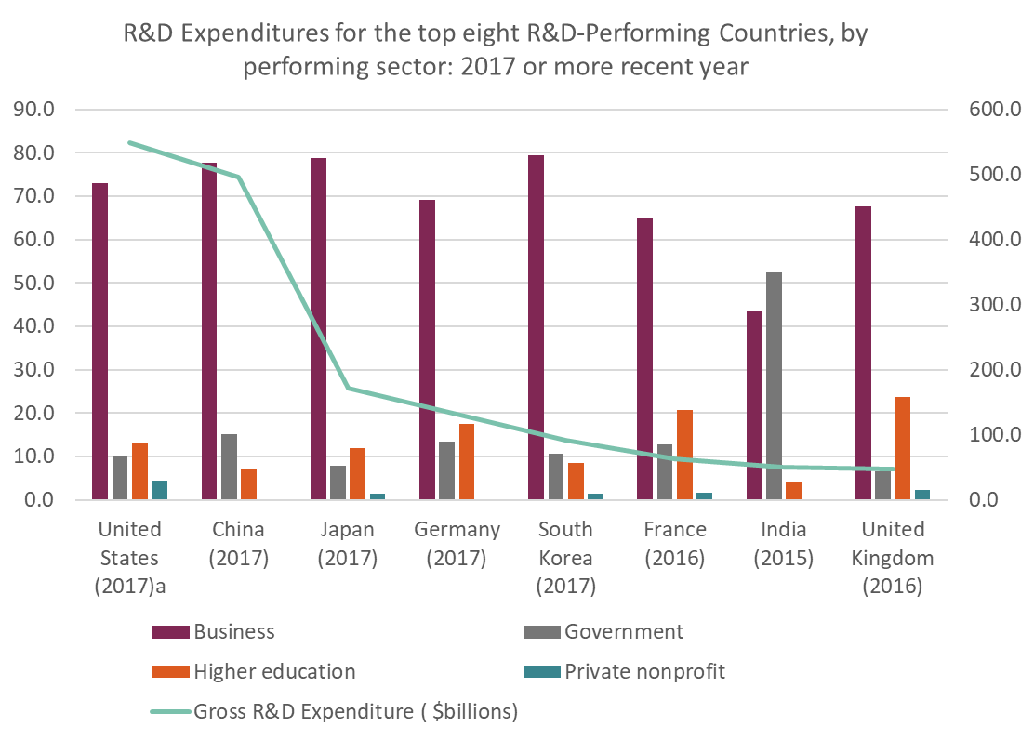
Total R&D Expenditures and Percent of R&D Funds by Performing Sector, by Country 2017
Access the text alternative for these images.

Slide 19
Innovation in Collaborative Networks 1
Collaborations include (but are not limited to):
Joint ventures.
Licensing and second-sourcing agreements.
Research associations.
Government-sponsored joint research programs.
Value-added networks for technical and scientific exchange.
Informal networks.
Collaborative research is especially important in high-technology sectors where individual firms rarely possess all necessary resources and capabilities.

Slide 20
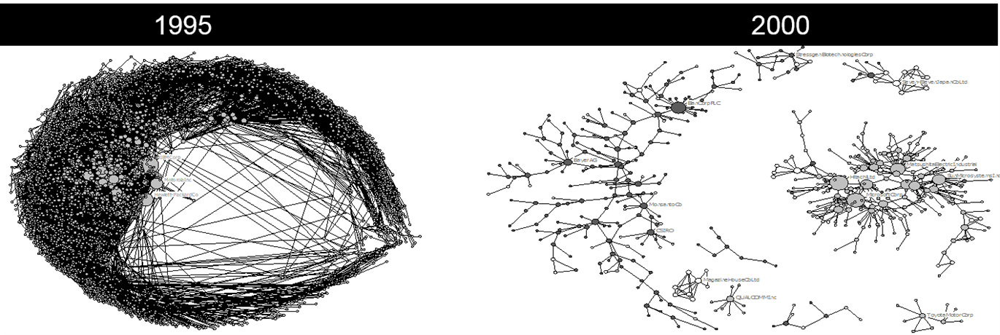
Innovation in Collaborative Networks 2
As firms forge collaborative relationships, they weave a larger network that influences the diffusion of information and other resources.
The size and structure of this network changes over time due to changes in alliance activity.
Access the text alternative for these images

Slide 21
Innovation in Collaborative Networks 3
Technology Clusters are regional clusters of firms that have a connection to a common technology.
May work with the same suppliers, customers, or complements.
Agglomeration Economies:
Proximity facilitates knowledge exchange.
Cluster of firms can attract other firms to area.
Supplier and distributor markets grow to service the cluster.
Cluster of firms may make local labor pool more valuable by giving them experience.
Cluster can lead to infrastructure improvements (for example, better roads, utilities, schools, etc.).
Agglomeration downsides:
Increased competition, knowledge leakage, congestion and pollution.

Slide 22
Innovation in Collaborative Networks 4
Likelihood of innovation activities being geographically clustered depends on:
The nature of the technology.
For example, its underlying knowledge base or the degree to which it can be protected by patents or copyright, the degree to which its communication requires close and frequent interaction;
Industry characteristics.
For example, degree of market concentration or stage of the industry lifecycle, transportation costs, availability of supplier and distributor markets; and
The cultural context of the technology.
For example, population density of labor or customers, infrastructure development, national differences in how technology development is funded or protected.

Slide 23
Innovation in Collaborative Networks 5
Technological spillovers occur when the benefits from the research activities of one entity spill over to other entities.
Likelihood of spillovers is a function of:
Strength of protection mechanisms (for example, patents, copyright, trade secrets).
Nature of underlying knowledge base (for example, tacit, complex).
Mobility of the labor pool.

Slide 24
Research Brief
Do Grant Innovation Prizes Work?
Prizes are most useful where traditional monetization methods might be poor, for example,
when patent rights are weak.
when development process takes so long as to be economically unattractive.
when benefits will be so diffuse as to lead to underinvestment in public good.
Example.
Xprize Foundation’s N R G COSIA Carbon Xprize for removing C O2 from the atmosphere.
48 teams entered the competition, nine made it to final round, vying for two prizes worth $10 million each.
Prizes can induce a wide range of participants to enter and yield a diverse array of solutions. The collective investment of participants may be much greater than the prize itself.

Slide 25
Discussion Questions
What are some of the advantages and disadvantages of a) individuals as innovators, b) firms as innovators, c) universities as innovators, d) government institutions as innovators, e) nonprofit organizations as innovators?
What traits appear to make individuals most creative? Are these the same traits that lead to successful inventions?
Could firms identify people with greater capacity for creativity or inventiveness in their hiring procedures?
To what degree do you think the creativity of the firm is a function of the creativity of individuals, versus the structure, routines, incentives, and culture of the firm? Can you give an example of a firm that does a particularly good job at nurturing and leveraging the creativity of its individuals?
Several studies indicate that the use of collaborative research agreements is increasing around the world. What are some reasons collaborative research might be becoming more prevalent?

Slide 26
Supplemental Video
A short video on.
Sources of Innovation: Individual Creativity.
https://youtu.be/j3jKzYnzC6c

Slide 27
End of Main Content
© McGraw Hill LLC. All rights reserved. No reproduction or distribution without the prior written consent of McGraw Hill LLC.

Slide 28
Accessibility Content: Text Alternatives for Images

Slide 29
Overview – Text Alternative
Return to parent-slide containing images.
A pentagram contains firms, universities, government funded research, private nonprofits, and individuals interconnected to each other.
Return to parent-slide containing images.

Slide 30
Total R&D Expenditures and Percent of R&D Funds by Performing Sector, by Country 2017 – Text Alternative
Return to parent-slide containing images.
The data is shown for business, higher education, gross R and D expenditures in billion dollars, government, private nonprofit. The values for the United States for the year 2017 reads: Business, 73. Government, 10. Higher education, 13. Private nonprofit, 4. The values for China for the year 2017 reads: Business, 78. Government, 15. Higher education, 8. The values for Japan for the year 2017 reads: Business, 79. Government, 8. Higher education, 12. Private nonprofit, 1. The value for Germany for the year 2017 reads: Business, 69. Government, 14. Higher education, 18. The values for South Korea for the year 2017 reads: Business, 79.5. Government, 11. Higher education, 9. Private nonprofit, 1. The values of France for the year 2016 reads: Business, 65. Government, 12. Higher education, 21. Private nonprofit, 2. The values of India for the year 2015 reads: Business, 44. Government, 53. Higher education, 4. The values of the United Kingdom for the year 2016 reads: Business, 68. Government, 7. Higher education, 23. Private nonprofit, 3. The graph representing the gross R and D expenditures in billion dollars has the values: the United States, 530. China, 480. Japan, 170. Germany, 110. South Korea, 100. France, 80. India, 50. The United Kingdom, 50.
Return to parent-slide containing images.

Slide 31
Innovation in Collaborative Networks 2 – Text Alternative
Return to parent-slide containing images.
An illustration shows the worldwide technological collaboration network in the year 19 95. The dense web of connected firms is seen mostly on the right. The central part of the web has the company names: I B M Corporation, Motorola Incorporated, and Hewlett Packard Company. To its right, an illustration shows the worldwide technological collaboration network in the year 2000. The once dense web is spread out into different parts. The spread out sections includes: Seven eleven Japan Company Limited, Stressgen Biotechnologies Corporation, Elan Corporation P L C, Bayer A G, Monsanto Company, C S I R O, Magazine House Company Limited, Qualcomm Incorporated, Toyota Motor Corporation. The central part of the web includes the companies: Matsushita Electric Industrial, Sun Microsystems Incorporated, Hitachi Incorporated, Microsoft Corporation.
Return to parent-slide containing images.

